Slide 1
EARLY PREDICTION OF LOW BIRTH WEIGHT (LBW) CASES USING MACHINE LEARNING APPROACH

Slide 2
INDEX
Abstract
Objective of project
Problem Statement
Scope & Motivation
Introduction
Literature survey
Existing Method
Disadvantages
Proposed method
Advantages
Project Flow
Hardware and Software Requirements
Architecture
Modules
UML Diagram
Output Screens
Conclusion
Future Work
References

Slide 3
ABSTRACT
Low Birth weight (LBW) acts as an indicator of sickness in newborn babies. LBW is closely associated with infant mortality as well as various health outcomes later in life.
Various studies show strong correlation between maternal health during pregnancy and the child’s birth weight.
The forecasting problem has been reformulated as a classiﬁcation problem between LBW and NOT-LBW classes using supervised Machine learning for LBW detection as a binary machine classiﬁcation problem.

Slide 4
OBJECTIVE OF PROJECT
The primary objective of this project is to develop a reliable machine learning-based system for the early prediction of low birth weight (LBW) cases. By leveraging data analysis and predictive modeling, we aim to identify pregnant individuals at risk of delivering LBW infants well in advance of birth. This system will enable timely medical interventions and targeted care strategies, ultimately improving neonatal health outcomes and reducing the associated risks for both mothers and infants.

Slide 5
PROBLEM STATEMENT
The problem of early prediction of low birth weight (LBW) cases using a machine learning approach is a critical healthcare challenge. LBW infants face higher risks of health complications and mortality. Current methods for identifying these cases often lack accuracy and timeliness. Leveraging machine learning to develop a robust predictive model is essential to enable early intervention and improve neonatal outcomes. Addressing this problem can enhance maternal and infant healthcare by reducing LBW-related risks.

Slide 6
SCOPE AND MOTIVATION
MotivationEarly prediction of low birth weight (LBW) cases using a machine learning approach is motivated by the urgent need to identify at-risk pregnancies in advance. By leveraging data-driven models, we aim to detect LBW cases at an early stage, enabling timely medical intervention and improved neonatal care.
Scope:- The scope of this project encompasses the development and implementation of a comprehensive machine learning solution for the early prediction of low birth weight (LBW) cases. It involves data collection, preprocessing, model training, and validation. The project will also explore various potential predictors and evaluate their impact on prediction accuracy.

Slide 7
INTRODUCTION
World Health Organization Maternal Health and Safe Motherhood Programme-1992, Low Birth Weight. It is expected to rise at the rate of 12% every year. Nearly 39% of power is used for cooling 45% for running the Information Technology (IT), infrastructure and 13% for lights. This level of consumption costs heavily to the businesses. LBW and prematurity remain a serious public health burden worldwide. Neonatal deaths account for a major fraction of deaths of children under the age of five, globally Children with LBW are at significantly higher risks of early childhood morbidity and mortality when compared with their counterparts with normal birth weights.Low birth weight is the term used to refer to babies born with a weight less than 2500gm Low birth weight (LBW) has been identiﬁed as a major public health problem around the world. LBW includes both pre-term babies as well as fully grown babies who are very small in size as a consequence of intra uterine growth retardation.

Slide 8
INTRODUCTION
Birth weight is closely associated with neonatal and infant mortality, mortality rates being signiﬁcantly higher in LBW babies when compared to the normal birth weight (NBW) babies. This phenomenon is now of global concern in the view of serious short term and long term problems such as development disorders, neurosensory outcomes, health outcomes including Type 2 diabetes, cerebral stroke, hypertension and various other disorders that LBW babies are prone to. Studies in 2013 showed that out of the 22 million newborns about 16 percent were low birth weight cases globally. This is a major problem in developing countries, especially in India which contributes to about 30 percent of the global LBW cases. Innumerable studies around the world indicate strong between maternal health and impact on birth weight of babies. Popular assumptions claim that LBW can be considerably reduced, with dedicated medical care during pregnancy. In our approach, the risk factors in pregnant women that can be easily assessed with basic methods are carefully examined throughout the gestation period and form the basis for predictions. Early detection can help in preventing the chances of LBW and also to put forward some recommendations under some intervention mechanisms.

Slide 9
LITERATURE SURVEY
S. NO | Journal Type with year | Authors | Title | Outcomes
1 | 2017 IEEE International Conference on Smart Computing | Anisha R. Yarlapati, Sudeepa Roy Dey, Snehanshu Saha | Early Prediction of LBW Cases via Minimum Error Rate Classifier: A Statistical Machine Learning Approach. | Fundamentals of data pre-processing techniques.
2 | Computer and Information Science, Studies in Computational Intelligence 2018. | Uzapi Cece Hange, Rajalakshmi Selvaraj. | A Data-Mining Model for Predicting Low Birth Weight with a High AUC. | Basics of Data Mining.

Slide 10
LITERATURE SURVEY
S. NO | Journal Type with year | Authors | Title | Outcomes
3 | International Conference on Industrial Engineering and Operations Management 2015. | Senthilkumar D , Paulraj S, | Prediction of Low Birth Weight Infants and Its Risk Factors Using Data Mining Techniques . | Fundamentals of Machine Learning Algorithms.
4 | Indonesian Journal of Science & Technology | Alfensi Faruk, Endro Setyo Cahyono. | Prediction and Classification of Low Birth Weight Data Using Machine Learning Techniques. | Fundamentals of Data Cleaning techniques

Slide 11
EXISTING SYSTEM
In existing system, model used is Random forest and Xgboost and Decision Tree to estimate whether the baby belongs to the Low Birth Weight or not belongs to the Low Birth. This model employs low accuracy and inaccurate results.

Slide 12
DISADVANTAGES
1. Low accuracy: The model's predictions do not align closely with the actual outcomes, resulting in a high rate of incorrect classifications and reduced trustworthiness.
2. Expensive: The implementation or maintenance of the solution incurs significant costs, potentially exceeding available resources and hindering widespread adoption.
3. Low reliability: The system lacks consistency in producing dependable results, making it unreliable for critical tasks or decision-making.
4. Inaccurate: The model's outputs deviate significantly from the ground truth, leading to incorrect conclusions and diminished utility in practical applications.

Slide 13
PROPOSED METHOD
In the proposed system, we employ a sophisticated approach that leverages supervised machine learning algorithms, specifically Stacking Algorithms and Support Vector Classifier (SVC), to enhance the prediction of low birth weight (LBW) cases in early pregnancy. Stacking enables the combination of diverse predictive models, while the SVC harnesses its classification capabilities to refine our LBW risk assessments. This comprehensive strategy harnesses the power of machine learning to create a robust and accurate framework for the early prediction of LBW cases, ultimately improving neonatal healthcare and maternal well-being.

Slide 14
ADVANTAGES
1. High accuracy: The system delivers exceptionally precise results, aligning closely with real-world outcomes, enhancing decision-making, and boosting confidence in its predictions.
2. Time-saving: It significantly reduces the time required for tasks or processes, increasing overall efficiency and productivity.
3. Does not require highly trained staff: It can be operated effectively by individuals with minimal training, reducing the need for specialized expertise.
4. High reliability: The system consistently produces dependable results, ensuring its suitability for critical applications and maintaining user trust.
5. Low complexities: It features a straightforward, user-friendly design with minimal intricacies, enhancing usability and ease of implementation.

Slide 15
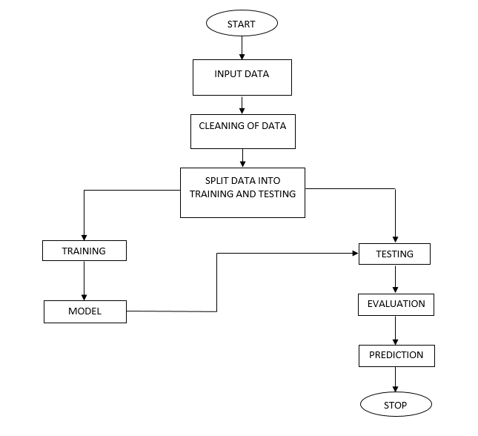
PROJECT FLOW
Figure: work Flow of Proposed system

Slide 16
HARDWARE & SOFTWARE REQUIREMENTS
SOFTWARE REQUIREMENS
Operating System : Windows 7+
Server-side Script : Python 3.6+
IDE : PyCharm.
Libraries Used : Pandas, Numpy, Matplotlib, OS.

Slide 17
HARDWARE & SOFTWARE REQUIREMENTS
HARDWARE REQUIREMENTS
Processor : I3/Intel Processor
RAM : 4GB (min)
Hard Disk : 128 GB
Key Board : Standard Windows Keyboard
Mouse : Two or Three Button Mouse
Monitor : Any

Slide 18
FUNCTIONAL AND NON-FUNCTIONAL REQUIREMENTS
Requirement’s analysis is very critical process that enables the success of a system or software project to be assessed. Requirements are generally split into two types: Functional and non-functional requirements.
.Functional Requirements: : These are the requirements that the end user specifically demands as basic facilities that the system should offer. All these functionalities need to be necessarily incorporated into the system as a part of the contract. These are represented or stated in the form of input to be given to the system, the operation performed and the output expected. They are basically the requirements stated by the user which one can see directly in the final product, unlike the non-functional requirements.

Slide 19
FUNCTIONAL AND NON-FUNCTIONAL REQUIREMENTS
Examples of functional requirements:
Authentication of user whenever he/she logs into the system
System shutdown in case of a cyber-attack
A verification email is sent to user whenever he/she register for the first time on some software system.
Non-functional requirementsThese are basically the quality constraints that the system must satisfy according to the project contract. The priority or extent to which these factors are implemented varies from one project to other. They are also called non-behavioral requirements.

Slide 20
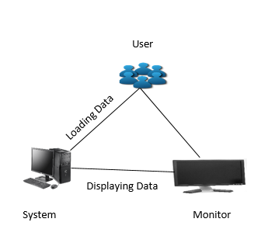
ARCHITECTURE

Slide 21
ALGORITHMS
XGBoost:
XGBoost is an algorithm that has recently been dominating applied machine learning and Kaggle competitions for structured or tabular data. XGBoost is an implementation of gradient boosted decision trees designed for speed and performance.
XGBoost is a decision-tree-based ensemble Machine Learning algorithm that uses a gradient boosting framework. In prediction problems involving unstructured data (images, text, etc.) artificial neural networks tend to outperform all other algorithms or frameworks. However, when it comes to small-to-medium structured/tabular data, decision tree based algorithms are considered best-in-class right now.
Bagging: Now imagine instead of a single interviewer, now there is an interview panel where each interviewer has a vote. Bagging or bootstrap aggregating involves combining inputs from all interviewers for the final decision through a democratic voting process.
XGBoost and Gradient Boosting Machines (GBMs) are both ensemble tree methods that apply the principle of boosting weak learners (CARTs generally) using the gradient descent architecture. However, XGBoost improves upon the base GBM framework through systems optimization and algorithmic enhancements.

Slide 22
Random Forest:
First, Random Forest algorithm is a supervised classification algorithm. We can see it from its name, which is to create a forest by some way and make it random. There is a direct relationship between the number of trees in the forest and the results it can get: the larger the number of trees, the more accurate the result. But one thing to note is that creating the forest is not the same as constructing the decision with information gain or gain index approach.
The author gives four advantages to illustrate why we use Random Forest algorithm. The one mentioned repeatedly by the author is that it can be used for both classification and regression tasks. Overfitting is one critical problem that may make the results worse, but for Random Forest algorithm, if there are enough trees in the forest, the classifier won’t overfit the model. The third advantage is the classifier of Random Forest can handle missing values, and the last advantage is that the Random Forest classifier can be modeled for categorical values.
There are two stages in Random Forest algorithm, one is random forest creation, the other is to make a prediction from the random forest classifier created in the first stage.

Slide 23
Decision Trees:
A tree has many analogies in real life, and turns out that it has influenced a wide area of machine learning, covering both classification and regression. In decision analysis, a decision tree can be used to visually and explicitly represent decisions and decision making. As the name goes, it uses a tree-like model of decisions. Though a commonly used tool in data mining for deriving a strategy to reach a particular goal.
A decision tree is drawn upside down with its root at the top. In the image on the left, the bold text in black represents a condition/internal node, based on which the tree splits into branches/ edges. The end of the branch that doesn’t split anymore is the decision/leaf, in this case, whether the passenger died or survived, represented as red and green text respectively.
Although, a real dataset will have a lot more features and this will just be a branch in a much bigger tree, but you can’t ignore the simplicity of this algorithm. The feature importance is clear and relations can be viewed easily. This methodology is more commonly known as learning decision tree from data and above tree is called Classification tree as the target is to classify passenger as survived or died. Regression trees are represented in the same manner, just they predict continuous values like price of a house. In general, Decision Tree algorithms are referred to as CART or Classification and Regression Trees.

Slide 24
Support Vector Machine:
A support vector machine (SVM) is a supervised machine learning model that uses classification algorithms for two-group classification problems. After giving an SVM model sets of labeled training data for each category, they’re able to categorize new text.
So you’re working on a text classification problem. You’re refining your training data, and maybe you’ve even tried stuff out using Naive Bayes. But now you’re feeling confident in your dataset, and want to take it one step further. Enter Support Vector Machines (SVM): a fast and dependable classification algorithm that performs very well with a limited amount of data to analyze.
Perhaps you have dug a bit deeper, and ran into terms like linearly separable, kernel trick and kernel functions. But fear not! The idea behind the SVM algorithm is simple, and applying it to natural language classification doesn’t require most of the complicated stuff.

Slide 25
Stacking Algorithm:
Stacking is an ensemble learning technique that combines the predictions of multiple machine learning models to improve overall predictive performance. It aims to harness the strengths of different base models and create a meta-model, or "stacker," that learns how to best combine their outputs. The process typically involves two or more levels of models. In the first level, various base models are trained on the same dataset. These base models can be diverse in terms of algorithms, such as decision trees, support vector machines, or neural networks. In the second level, a meta-model, often a simple linear regression or another machine learning algorithm, is trained on the predictions made by the base models in the first level. Stacking leverages the complementary strengths of base models to make more accurate predictions and is known for its ability to handle complex relationships in data. It can be particularly effective in tasks where individual models may struggle, ultimately enhancing the predictive power of machine learning systems. However, it requires careful tuning and may be computationally intensive due to its multi-level nature.

Slide 26
UML DIAGRAMS
Use Case Diagram:
A use case diagram in the Unified Modeling Language (UML) is a type of behavioral diagram defined by and created from a Use-case analysis.
Its purpose is to present a graphical overview of the functionality provided by a system in terms of actors, their goals (represented as use cases), and any dependencies between those use cases.
The main purpose of a use case diagram is to show what system functions are performed for which actor. Roles of the actors in the system can be depicted

Slide 27
UML DIAGRAMS
Figure: Use Case Diagram

Slide 28
UML DIAGRAMS
Class Diagram:
In software engineering, a class diagram in the Unified Modeling Language (UML) is a type of static structure diagram that describes the structure of a system by showing the system's classes, their attributes, operations (or methods), and the relationships among the classes. It explains which class contains information.
.

Slide 29
UML DIAGRAMS
Figure: Class diagram

Slide 30
UML DIAGRAMS
Sequence Diagram:
A sequence diagram in Unified Modeling Language (UML) is a kind of interaction diagram that shows how processes operate with one another and in what order.
It is a construct of a Message Sequence Chart. Sequence diagrams are sometimes called event diagrams, event scenarios, and timing diagrams.

Slide 31
UML DIAGRAMS
Figure: Sequence diagram

Slide 32
UML DIAGRAMS
Collaboration Diagram:
In collaboration diagram the method call sequence is indicated by some numbering technique as shown below. The number indicates how the methods are called one after another. We have taken the same order management system to describe the collaboration diagram. The method calls are similar to that of a sequence diagram. But the difference is that the sequence diagram does not describe the object organization where as the collaboration diagram shows the object organization.

Slide 33
UML DIAGRAMS
Figure: Collaboration diagram

Slide 34
UML DIAGRAMS
Deployment Diagram
Deployment diagram represents the deployment view of a system. It is related to the component diagram. Because the components are deployed using the deployment diagrams.
A deployment diagram consists of nodes. Nodes are nothing but physical hardware used to deploy the application.

Slide 35
UML DIAGRAMS
Figure: Deployment diagram

Slide 36
UML DIAGRAMS
Activity Diagram:
Activity diagrams are graphical representations of workflows of stepwise activities and actions with support for choice, iteration and concurrency. In the Unified Modeling Language, activity diagrams can be used to describe the business and operational step-by-step workflows of components in a system. An activity diagram shows the overall flow of control.

Slide 37
UML DIAGRAMS
Figure: Activity diagram

Slide 38
UML DIAGRAMS
Component Diagram:
A component diagram, also known as a UML component diagram, describes the organization and wiring of the physical components in a system.
Component diagrams are often drawn to help model implementation details and double-check that every aspect of the system's required functions is covered by planned development.

Slide 39
UML DIAGRAMS
Figure: Component diagram

Slide 40
UML DIAGRAMS
ER Diagram:
An Entity–relationship model (ER model) describes the structure of a database with the help of a diagram, which is known as Entity Relationship Diagram (ER Diagram). An ER model is a design or blueprint of a database that can later be implemented as a database. The main components of E-R model are: entity set and relationship set.
An ER diagram shows the relationship among entity sets. An entity set is a group of similar entities and these entities can have attributes. In terms of DBMS, an entity is a table or attribute of a table in database, so by showing relationship among tables and their attributes, ER diagram shows the complete logical structure of a database. Let’s have a look at a simple ER diagram to understand this concept.

Slide 41
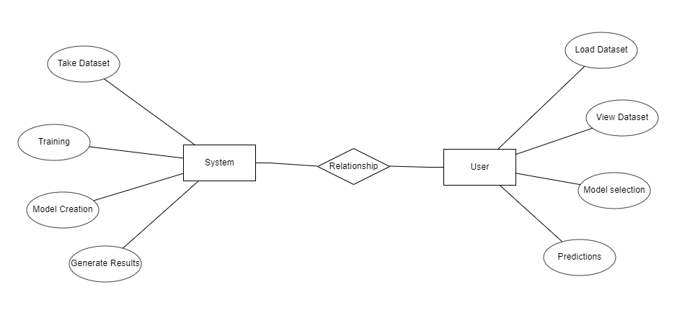
UML DIAGRAMS
Figure: ER diagram

Slide 42
UML DIAGRAMS
DFD Diagram:
A Data Flow Diagram (DFD) is a traditional way to visualize the information flows within a system. A neat and clear DFD can depict a good amount of the system requirements graphically. It can be manual, automated, or a combination of both. It shows how information enters and leaves the system, what changes the information and where information is stored. The purpose of a DFD is to show the scope and boundaries of a system as a whole. It may be used as a communications tool between a systems analyst and any person who plays a part in the system that acts as the starting point for redesigning a system.

Slide 43
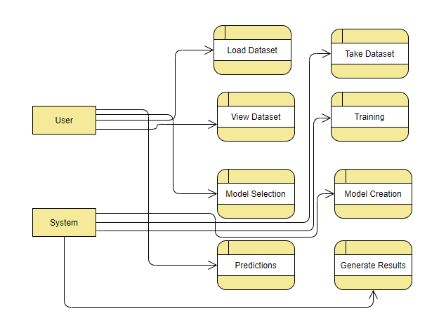
UML DIAGRAMS
Figure: Context Level diagram

Slide 44
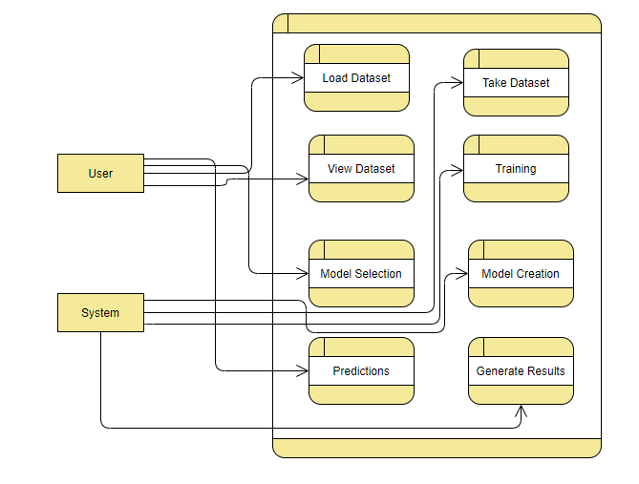
UML DIAGRAMS
FigureLevel-1 diagram

Slide 45
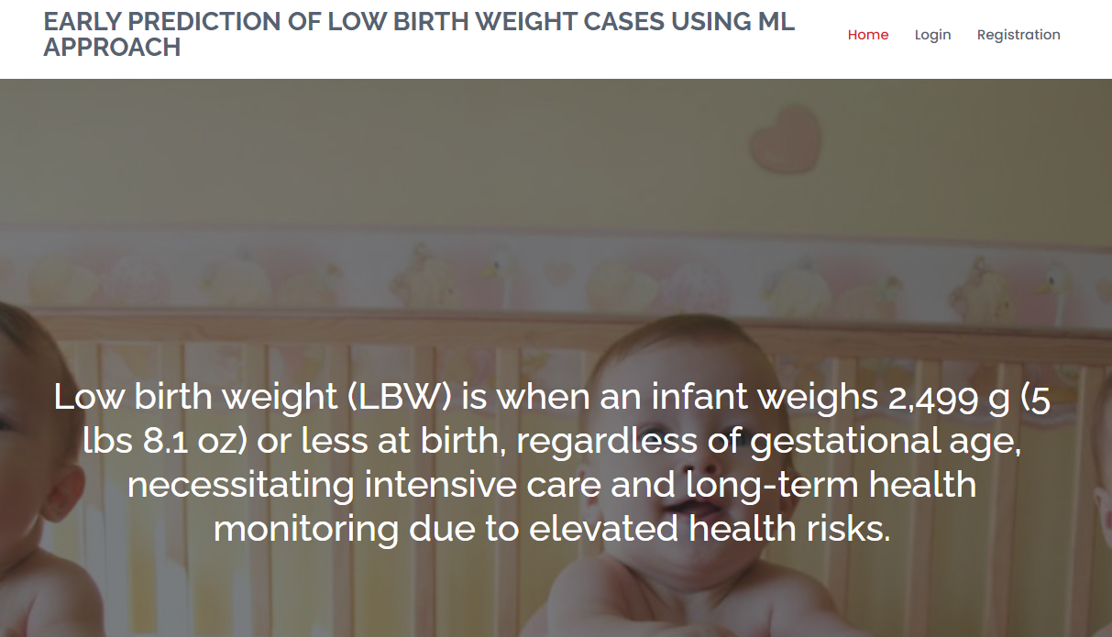
OUTPUT SCREENS
HOME PAGE:
This the homepage of lower birth weight prediction web application.

Slide 46
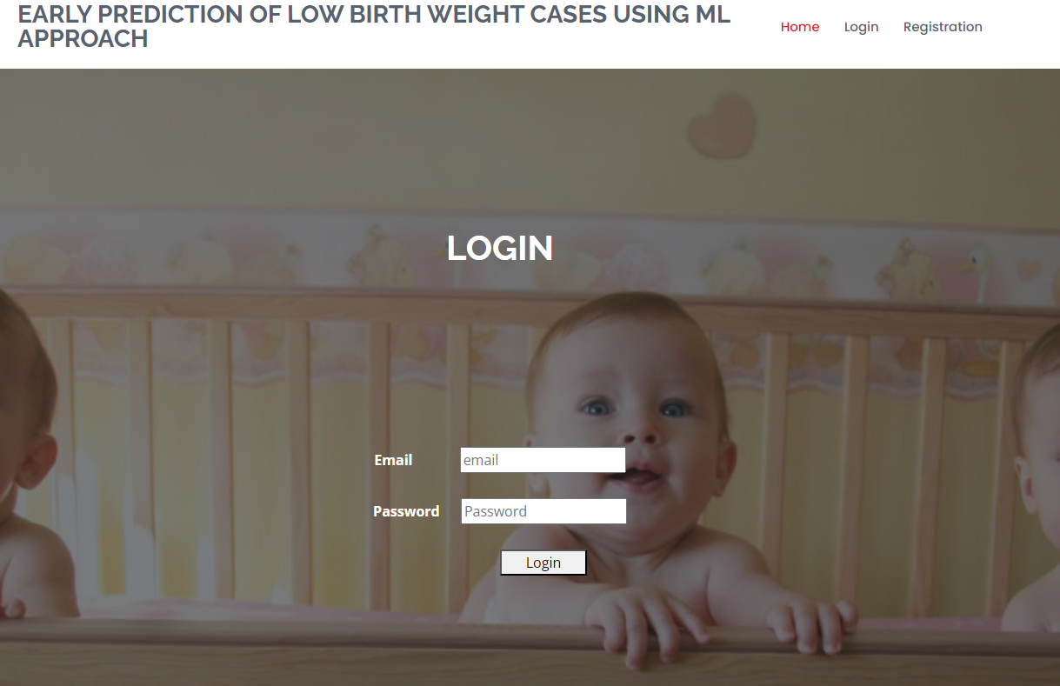
Login Page:

Slide 47
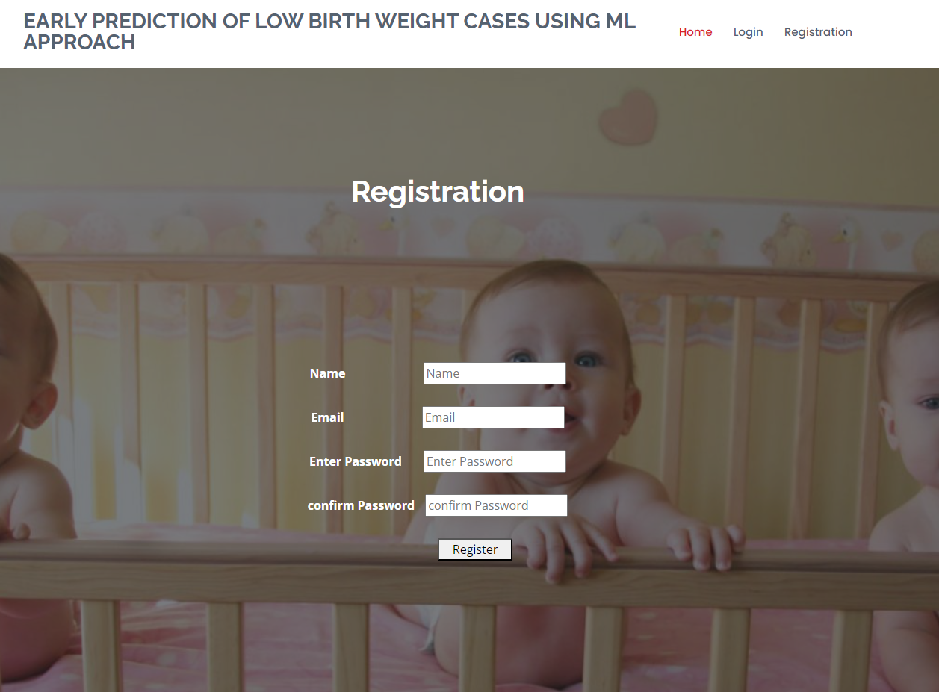
Registration:

Slide 48
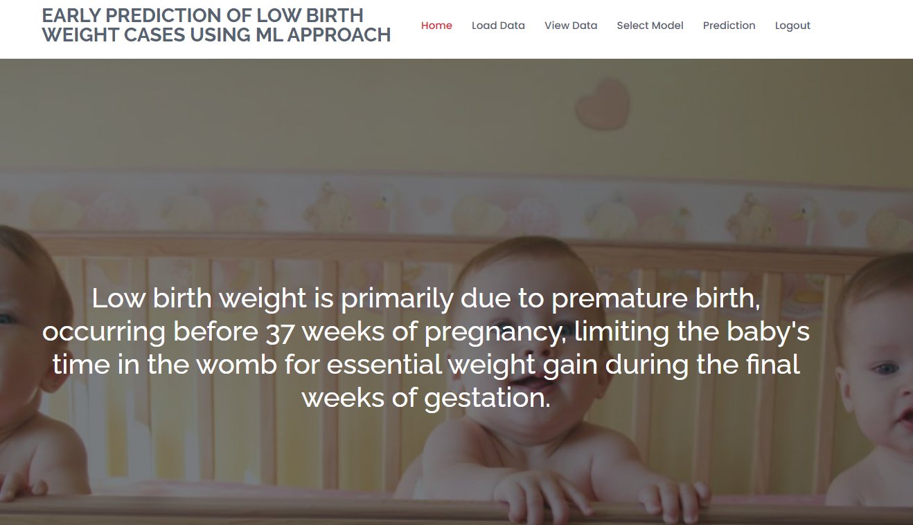
User Home Page:

Slide 49
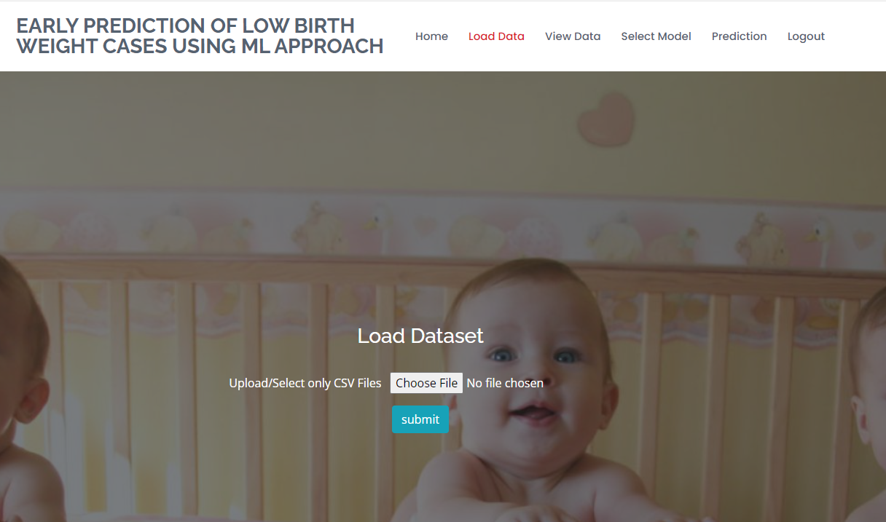
OUTPUT SCREENS
DATA LOADING PAGE:
In this page user have to upload the dataset.

Slide 50
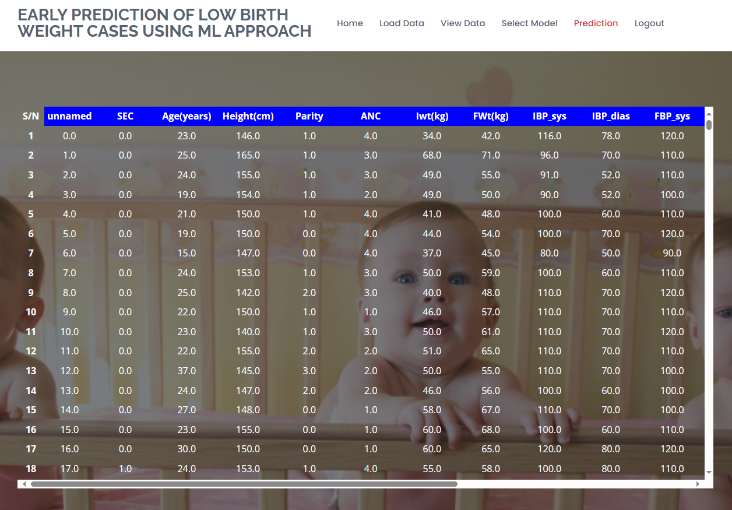
OUTPUT SCREENS
DATA VIEWING PAGE:
User can view the data in this page after Uploading dataset as input.

Slide 51
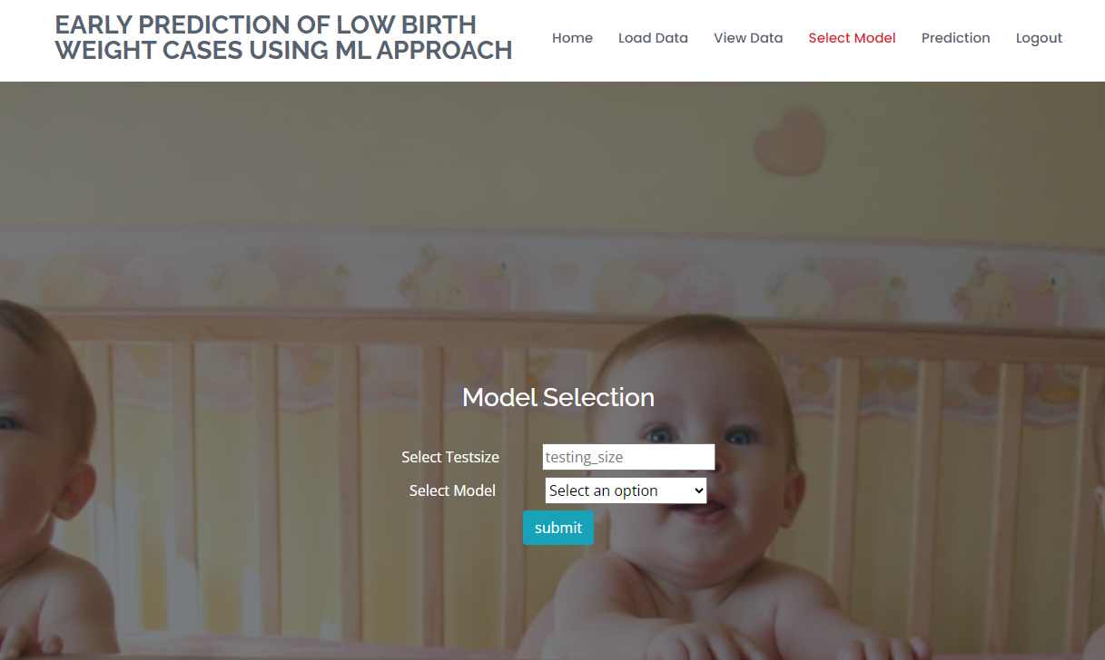
OUTPUT SCREENS
MODEL SELECTION:
This page is model selection page.User can provide the model and textsize .

Slide 52
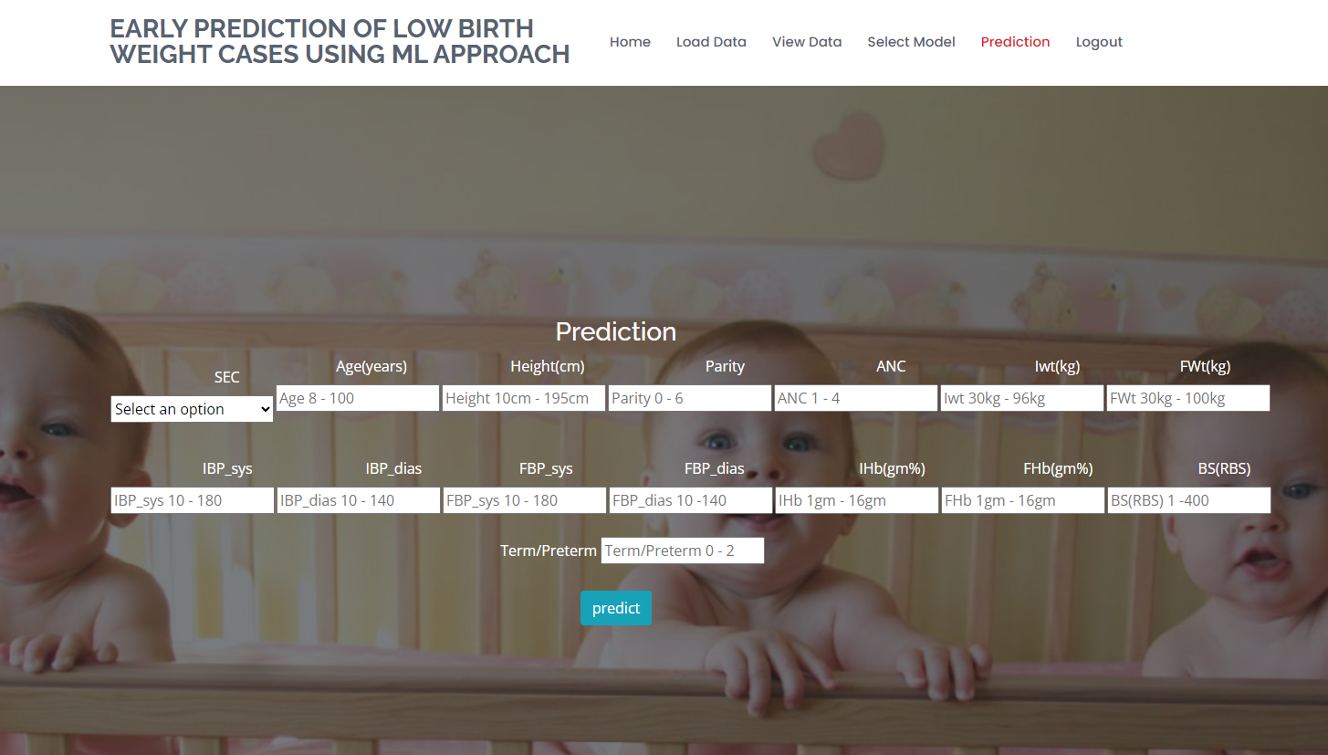
OUTPUT SCREENS
PREDICTION PAGE:
User can view the prediction page after providing the input dataset

Slide 53
CONCLUSION
In this application, we have successfully created a ML models to estimate whether the baby belongs to the Low Birth Weight or not belongs to the Low Birth.
This is developed in a user friendly environment using Flask via Python programming.
We noticed that out of XGBoost Classifier, Random Forest Classifier, Decision Tree Classifier, Support Vector Classifier Decision Tree Classifier and stacking classifier performs well with better accuracy.

Slide 54
FUTURE ENHANCEMENT
Future enhancements for the early prediction of low birth weight (LBW) cases using machine learning can encompass several avenues of improvement. Firstly, the integration of more comprehensive and diverse data sources, including genetic, environmental, and lifestyle factors, can refine predictive models for greater accuracy.Additionally, the development of real-time monitoring systems, using wearable devices and continuous data streams, could enable dynamic risk assessment throughout pregnancy. This could facilitate timely interventions and personalized care plans.Moreover, leveraging advanced deep learning techniques, such as neural networks and recurrent neural networks, may capture complex temporal patterns in maternal health data more effectively, further enhancing prediction accuracy.Lastly, collaboration with healthcare professionals and institutions can ensure the seamless integration of machine learning models into clinical practice, fostering a holistic approach to LBW risk mitigation. These future enhancements collectively hold the potential to revolutionize LBW prediction, leading to improved maternal and neonatal healthcare outcomes.

Slide 55
REFERENCES
[1] World Health Organization-1992, International statistical classiﬁcation of diseases and related health problems,Tenth revision, Geneva, World Health Organization.
[2] Kramer MS. Determinants of low birth weight: methodological assessment and meta-analysis. Bull World Health Organ. 1987; 65(5):663-737. PMID: 3322602; PMCID: PMC2491072.
[3] Vega J, Sáez G, Smith M, Agurto M, Morris NM. Factores de riesgo para bajo peso al nacer y retardo de crecimiento intrauterino en Santiago de Chile [Risk factors for low birth weight and intrauterine growth retardation in Santiago, Chile]. Rev Med Chil. 1993 Oct; 121(10):1210-9. Spanish. PMID: 8191127.

Slide 56
REFERENCES
[4] Mavalankar DV, Trivedi CC, Gray RH. Maternal weight, height and risk of poor pregnancy outcome in Ahmedabad, India. Indian Pediatr. 1994 Oct; 31(10):1205-12. PMID: 7875780.
[5] Bosetti C, Nieuwenhuijsen MJ, Gallus S, Cipriani S, La Vecchia C, Parazzini F. Ambient particulate matter and preterm birth or birth weight: a review of the literature. Arch Toxicol. 2010 Jun; 84(6):447-60. Doi: 10.1007/s00204-010-0514-z. Epub 2010 Feb 6. PMID: 20140425.
[6] United nations Children’s Fund and World Health Organization2004, Low Birth Weight: Country, regional and global estimates, New York, UNICEF

Slide 57
REFERENCES
.[7] J.S. Deshmukh, D.D. Motghare, S.P. Zodpey and S.K. Wadhva1998, Low Birth Weight And Associated Maternal Factors in an Urban Area, Indian Pediatrics,Volume 35, Page 33-36.
[8] J.S. Deshmukh, D.D. Motghare, S.P. Zodpey and S.K. Wadhva1998, Low Birth Weight And Associated Maternal Factors in an Urban Area, Indian Pediatrics,Volume 35, Page 33-36.
[9] Aparajita Dasgupta, Rivu Basu, “Determinants of low birth weight in a Blowk of Hooghly, West Bengal: A multivariate analysis,” International Journal of Biological & Medical Research, 2(4), 2011, pp.838-842.
[10] Bellazzi R, Zupan B., “Towards knowledge-based gene expression data mining”, J Biomed Inform. 2007; 40(6), pp.787-802

